Slide 1
Requirements Engineering
Chapter 7: Requirements Specification and Agile Methods
George Edwards
Computer Science Department
University of Southern California
gedwards@usc.edu

Slide 2
Today’s Agenda
Ch. 6 quiz
Review Ch. 5 quiz
Finish DOORS tutorial
Student presentations
Agile Requirements Engineering Practices: An Empirical Study
Ch. 7 lecture
Ch. 7 homework discussion

Slide 3
Topics
Introduction to Agile Software Development
Extreme Programming and Scrum
Writing user stories
Challenges for RE and Agile Methodologies

Slide 4
Agile Manifesto
We are uncovering better ways of developing software by doing it and helping others do it. Through this work we have come to value:
Individuals and interactions over processes and tools
Working software over comprehensive documentation
Customer collaboration over contract negotiation
Responding to change over following a plan
That is, while there is value in the items on the right, we value the items on the left more.

Slide 5
Principles Behind Agile Manifesto
Our highest priority is to satisfy the customer through early and continuous delivery of valuable software.
Welcome changing requirements, even late in development.
Agile processes harness change for the customer's competitive advantage.
Deliver working software frequently, from a couple of weeks to a couple of months, with a preference to the shorter timescale.
Business people and developers must work together daily throughout the project.
Build projects around motivated individuals.
Give them the environment and support they need, and trust them to get the job done.
The most efficient and effective method of conveying information to and within a development team is face-to-face conversation.

Slide 6
Principles Behind the Agile Manifesto
Working software is the primary measure of progress.
Agile processes promote sustainable development. The sponsors, developers, and users should be able to maintain a constant pace indefinitely.
Continuous attention to technical excellence and good design enhances agility.
Simplicity – the art of maximizing the amount of work not done – is essential. Do the simplest thing that could possibly work.
The best architectures, requirements, and designs emerge from self-organizing teams.
At regular intervals, the team reflects on how to become more effective, then tunes and adjusts its behavior accordingly.

Slide 7
Requirements Engineering in Agile Methodologies
Agile methods address one of the biggest challenges in software development: changing requirements.
A major difference between traditional and agile methodologies is in the gathering of requirements.
Requirements engineering approaches for agile methodologies tend to be much more informal.
Some proponents of agile methodologies use requirements engineering practices as a selling point for agile.

Slide 8
Comparison of Waterfall, Iterative, and Agile Development Cycles
Agile

Slide 9
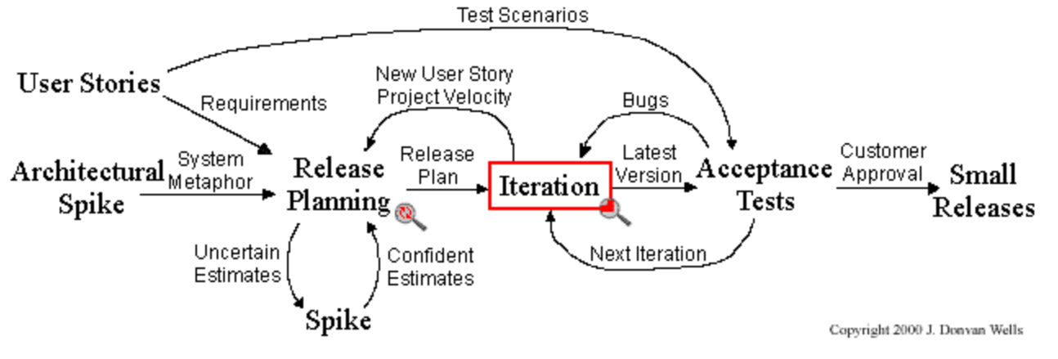
Extreme Programming (XP)
User stories: about three sentences of text written by the customer in the customers terminology stating what the system needs to do for them.
System metaphor: a story that everyone - customers, programmers, and managers - can tell about how the system works.
Release planning: a practice where the customer presents the desired features to the programmers, and the programmers estimate their difficulty.
Iteration planning meeting: called at the beginning of each iteration to choose user stories to be implemented. Each iteration is 1 to 3 weeks long.
Spike solution: a very simple program to explore potential solutions.
Project velocity: a measure of how much work is getting done on your project computed as the sum of the estimates of the user stories that were finished.

Slide 10
XP Practices
The customer is always available
Preferably face to face, on site
A stand up meeting starts each day
10 minutes or less
Use an open work space
Put computers in a central area that no one owns
Move people around and use collective ownership
Force programmers to work on all parts of the system
Code the unit test first
When a bug is found, tests are created
Refactor continuously
Remove redundancy, eliminate unused functionality, and rejuvenate obsolete designs
All code is pair programmed
Two people working together at a single computer

Slide 11
Scrum
A product backlog of prioritized work (requirements) is created
Development occurs in fixed time intervals called sprints
Creates a useable and potentially releasable product increment
Consistent durations throughout a development effort (usually 30 days)
A new sprint starts immediately after the conclusion of the previous sprint
Sprint planning determines work to be performed in next sprint
Max 8 hours
Items are selected from product backlog
Sprint goal is decided: one coherent function that can be met through the implementation of product backlog
Daily scrums synchronize activities and create a plan for the next 24 hours
15 minute meeting
Progress, upcoming work, and impediments are discussed
Only development team members participate

Slide 12
Scrum
Sprint review inspects the increment and adapts the product backlog if needed
Held at the end of the sprint
4 hours max
Involves Scrum Team and stakeholders
Sprint retrospective identifies successes and potential improvements
Occurs after sprint review and before sprint planning
3 hours max
Scrum Team only

Slide 13
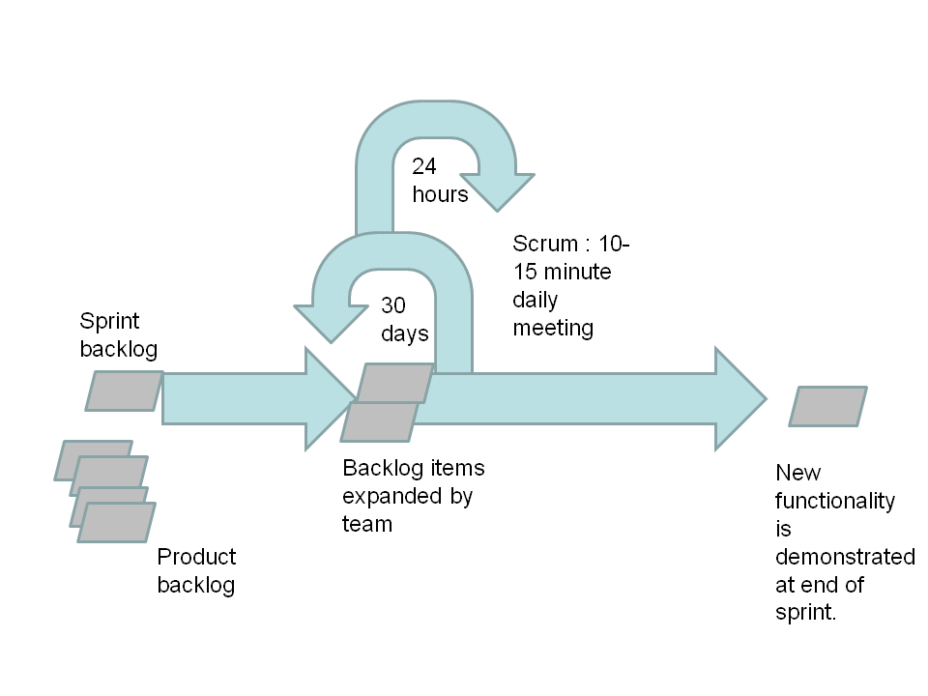
Scrum

Slide 14
Scrum Team
Product Owner
One person
Manages the product backlog
Responsible for maximizing the value of the product
Has final authority for requirement prioritization
Development Team
Self-organizing team (usually 3-9 people, no titles or sub-teams)
Turns the product backlog into an increment
Scrum Master
Ensures Scrum is understood and enacted
Facilitates and encourages Scrum practices
Helps those outside the Scrum Team understand which of their interactions with the Scrum Team are helpful and which aren’t

Slide 15
Sprint Backlog
Three backlog (requirements) types
Product
List of everything that might be needed in the product
Acts as a repository for requirements targeted for release at some point
Typically high level requirements
Never complete – evolves as the product and environment evolve
Release
A prioritized set of items from product backlog
Contains more details and low level effort estimates
Sprint
Set of release requirements that the team will complete (fully coded, tested, and documented) at the end of the sprint

Slide 16
Backlog Relationship
Product
Release
sprint
Release
sprint
sprint

Slide 17
Characteristics of Agile Methods
Informal requirements specifications (user stories, backlog)
Fixed duration development increments (iteration, sprint)
Short daily meetings (stand up meeting, scrum)
Progress metrics (task estimation, project velocity)

Slide 18
Requirements Engineering : Agile versus Traditional
 | Traditional | Agile
When requirements gathered? | Usually at the front end of the process | Always ongoing
Who gathers the requirements? | One or a few requirements engineers | All developers
Customer interaction | Limited to requirements engineers | All developers
Feedback to customers on requirements implementation | Sporadic, mostly at the end during acceptance testing | Ongoing
Customer involvement | Low | High
Vulnerability to changing requirements | High | Low

Slide 19
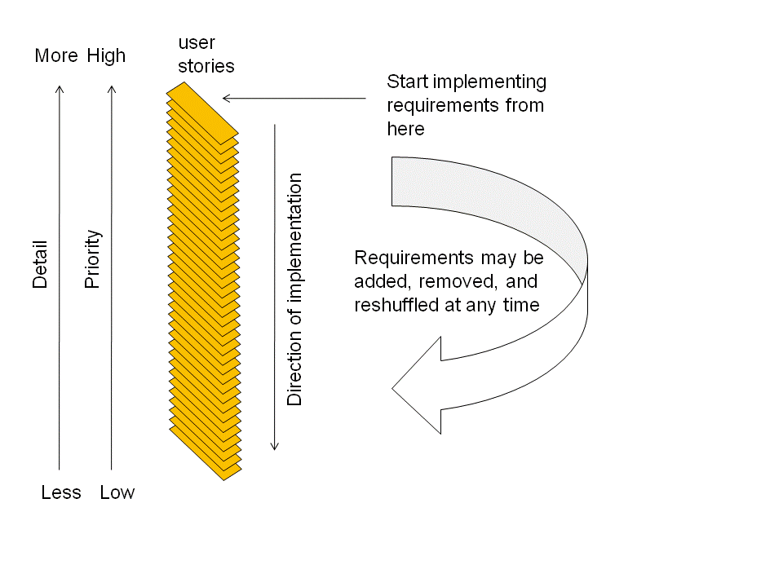
Agile Requirements Change Management Process
Source: Ambler 2007

Slide 20
User Stories and Agile RE
User stories are the most basic unit of requirements in most agile methodologies
Each user story represents a feature desired by the customer
User stories are written by the customer on index cards (though they can be automated via wikis or other tools)
Formal requirements and use cases are derived from the user stories by the software engineering team as needed
Source: Williams

Slide 21
User Stories and Agile RE
User stories are used for effort and cost estimation
Initial user stories are usually gathered in small offsite meetings
Stories can be generated either through goal-oriented approaches (e.g., “let’s discuss how a customer makes a purchase”) or through interactive approaches (stream-of-consciousness)
Developing user stories is an “iterative and interactive” process
Testability of each story is considered by the development team
The development team also manages the size of stories for uniformity (e.g. too large – split, too small – combine)
Source: Williams

Slide 22
User Story Components
Title – a short handle for the story; present tense verb in active voice is desirable
Acceptance test – a unique identifier that will be the name of a method to test the story
Priority – based on the prioritization scheme adopted
Story points – estimated time to implement (e.g., 1-3 days in XP)
Description – one to three sentences describing the story
Source: Williams

Slide 23
User Story Layout
Title
Acceptance Test
Priority
Story Points
Description
3 by 5 index card

Slide 24
User Story: Pet Store POS
Title: Customer Returns Items
Acceptance Test: custRetItem
Priority: 1
Story Points:2
When a customer returns an item, its purchase should be authenticated. If the purchase was authentic then the customer’s account should be credited or the purchase amount returned. The inventory should be updated accordingly.
1= high priority, 1 story point = 1 day
Source: Williams

Slide 25
User Story: Baggage Handling
Title: Detect Security Threat
Acceptance Test: detSecThrt
Priority: 1
Story Points:3
When a scanned bag has been determined to contain an instance of a banned item, the bag shall be diverted to the security checkpoint conveyor. The security manager shall be sent an email stating that a potential threat has been detected.
1= high priority, 1 story point = 1 day
Source: Williams

Slide 26
Criteria for User Stories
Stories should be understandable to the customers
Each story should add value
Developers do not write user stories
Stories need to be small enough that several can be completed per iteration
Stories should be independent (as much as possible)
Stories must be testable – like any requirement, if it cannot be tested, it’s not a requirement!
Source: Williams

Slide 27
Agile Requirements Best Practices
Stakeholders actively participate
Adopt stakeholder terminology
Frequent, personal interaction
Implement requirements, do not document them
Express requirements as features
Treat requirements like a prioritized stack
Adopt inclusive models
Create platform independent requirements
Use user stories
Smaller is better
Frequent delivery of software

Slide 28
Challenges for RE and Agile Methodologies
Dealing with non-functional requirements
Because they are not always apparent when dealing with requirements functionally only
User stories can be augmented with appropriate NFRs
Customer interaction is strong – but mostly through prototyping
Using various interviewing techniques would be desirable
Validation is strong through testing, but verification is weak
Using formal methods could strengthen agile RE
Large-scale projects
Teams are limited in size

